Slide 1
Brain tumor detection using multi-classification
Paper by:Pallavi Tiwari, Bhaskar Pant, Mahmoud M. Elarabawy, Mohammed Abd-Elnaby, Noor Mohd, 1 Gaurav Dhiman, 1 and Subhash Sharma.
Published 21 june 2020;

Slide 2
intro:
Brain tumors are the 10th leading reason for the death which is common among the adults and children.
For that we are going to discuss CNN model for classifying brain tumor using MRI pictures.
Our model classifies brain tumor into four classes: no tumor, glioma, meningioma, and pituitary tumor.

Slide 3
The data set we used in our model is Brain Tumor Classification (MRI) from the Kaggle licensed CCO: Public Domain.
It contains a total of 8165 MRIs.

Slide 4
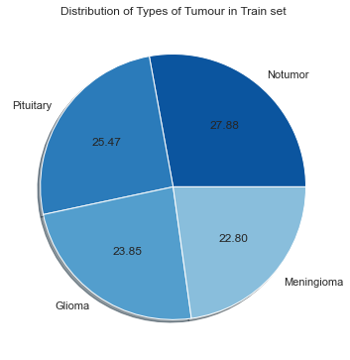
The dataset is categorized into two different parts training and testing dataset.
In the training dataset, the MRIs are distributed into four classes having 1,321, 1,339, 1,595, and 1,457brain MRIs of glioma, meningioma, no tumor, and pituitary tumors, respectively.
Similarly, in the testing dataset, there are 300, 306, 105, and 74 brain MRIs of glioma, meningioma, no tumor, and pituitary tumor, respectively .

Slide 5
Why CNN?
Because CNN has shown to be the most successful DL technique for analyzing medical images.
It has a convolutional layer, activation layer, a batch normalization layer, a pooling layer, and a classification layer.
we will briefly talk about each of them:

Slide 6
A convolutional layer is responsible for recognizing features in pixels.
Batch Normalization Layer this layer’s primary function is to normalize the output of the layer previously. It may be utilized to prevent the problem of overfitting.
Activation Layer . one of the most essential parameters of the CNN model is the activation function. It defines which model information should be sent forward and which should not at the network’s end.

Slide 7
Pooling Layer: the work of this layer is to reduce the size of the feature map that means lowering the number of parameters and calculations needed to run the network.(the feature map is the output of the convolutional layer).
Classification Layer: the classification layer is the last layer in a CNN architecture. It is a fully connected feedforward network that’s frequently utilized as a classifier.

Slide 8
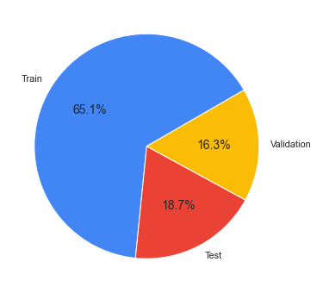
We will work on the below data precentages

Slide 9
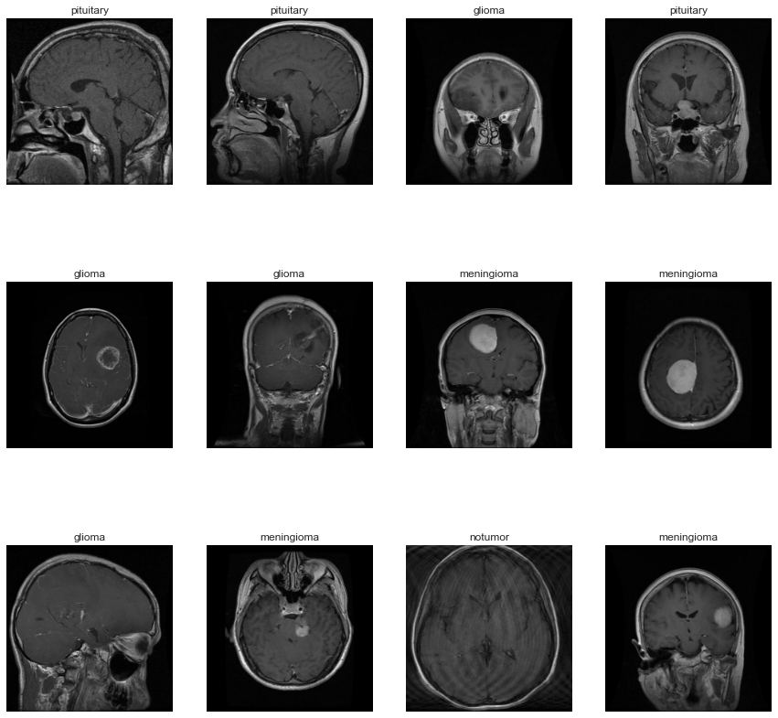
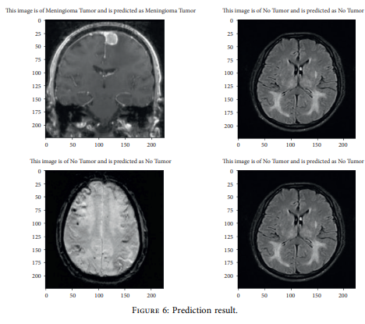
Some Samples

Slide 10
Our CNN model:
The CNN model compromises of 24 layers with weight, five conv2D layers, 1 fully connected, and one output layer or classification layer. It also has activation (ReLU), 4 dropouts, 5 batch_normalization, one flatten, and 2 max-pooling layers in addition to these.

Slide 11
Our Model's Summary
Model: "sequential" _________________________________________________________________ Layer (type) Output Shape Param # ================================================================= rescaling (Rescaling) (None, 224, 224, 3) 0 conv2d (Conv2D) (None, 224, 224, 64) 1792 activation (Activation) (None, 224, 224, 64) 0 conv2d_1 (Conv2D) (None, 222, 222, 64) 36928 batch_normalization (BatchN (None, 222, 222, 64) 256 ormalization) conv2d_2 (Conv2D) (None, 222, 222, 64) 36928 activation_1 (Activation) (None, 222, 222, 64) 0 max_pooling2d (MaxPooling2D (None, 111, 111, 64) 0 ) batch_normalization_1 (Batc (None, 111, 111, 64) 256 hNormalization) dropout (Dropout) (None, 111, 111, 64) 0 conv2d_3 (Conv2D) (None, 109, 109, 64) 36928 activation_2 (Activation) (None, 109, 109, 64) 0 max_pooling2d_1 (MaxPooling (None, 54, 54, 64) 0 2D)
batch_normalization_2 (Batc (None, 54, 54, 64) 256 hNormalization)
dropout_1 (Dropout) (None, 54, 54, 64) 0 conv2d_4 (Conv2D) (None, 52, 52, 64) 3692
activation_3 (Activation) (None, 52, 52, 64) 0 batch_normalization_3 (Batc (None, 52, 52, 64) 256 hNormalization) flatten (Flatten) (None, 173056) 0 dropout_2 (Dropout) (None, 173056) 0 dense (Dense) (None, 512) 88605184 activation_4 (Activation) (None, 512) 0 batch_normalization_4 (Batc (None, 512) 2048 hNormalization) outputs (Dense) (None, 4) 2052 ================================================================= Total params: 88,759,812 Trainable params: 88,758,276 Non-trainable params: 1,536

Slide 12
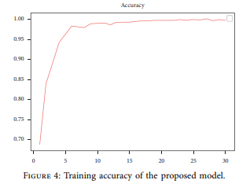
The model evaluation
The accuracy for our model

Slide 13
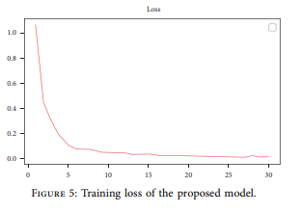
The loss

Slide 14
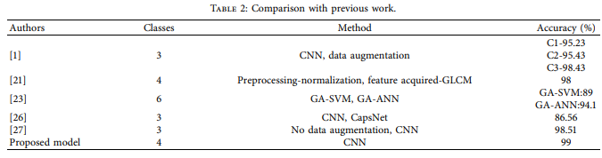
Comparison with previous work:
Our Model 4 CNN 91

Slide 15
If you want to read more about our model follow the link of the paper below:
https://www.researchgate.net/publication/361460064_CNN_Based_Multiclass_Brain_Tumor_Detection_Using_Medical_Imaging

